Slide 1





The Modern Web Development Landscape: Rendering paradigms
Salinda Ekanayake
Senior Software Consultant
Notes:
Welcome to our webinar on The modern web development and its rendering patterns.
As you all know website and web application have evolved into complex piece software from there simple beginning at introduction of www.

Slide 2
What is "Rendering" ?

Slide 3
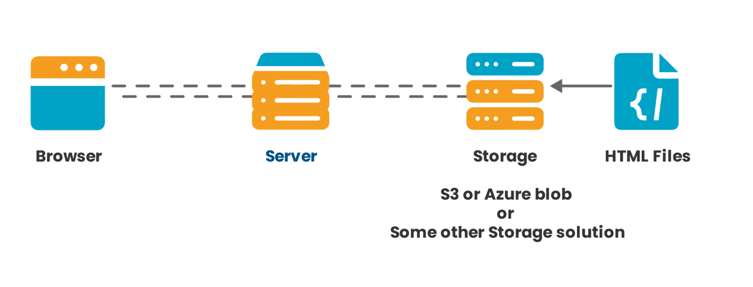
Static Website
The Modern Web Development Landscape: Rendering paradigms

Slide 4
Static Website
HTML/CSS
JavaScript
What tools do you need?
Cloud Storage space.
Eg- s3 or Azure blob storage.
OR Static site generators
The Modern Web Development Landscape: Rendering paradigms

Slide 5



Static Website (Static Site Generators)
The Modern Web Development Landscape: Rendering paradigms

Slide 6
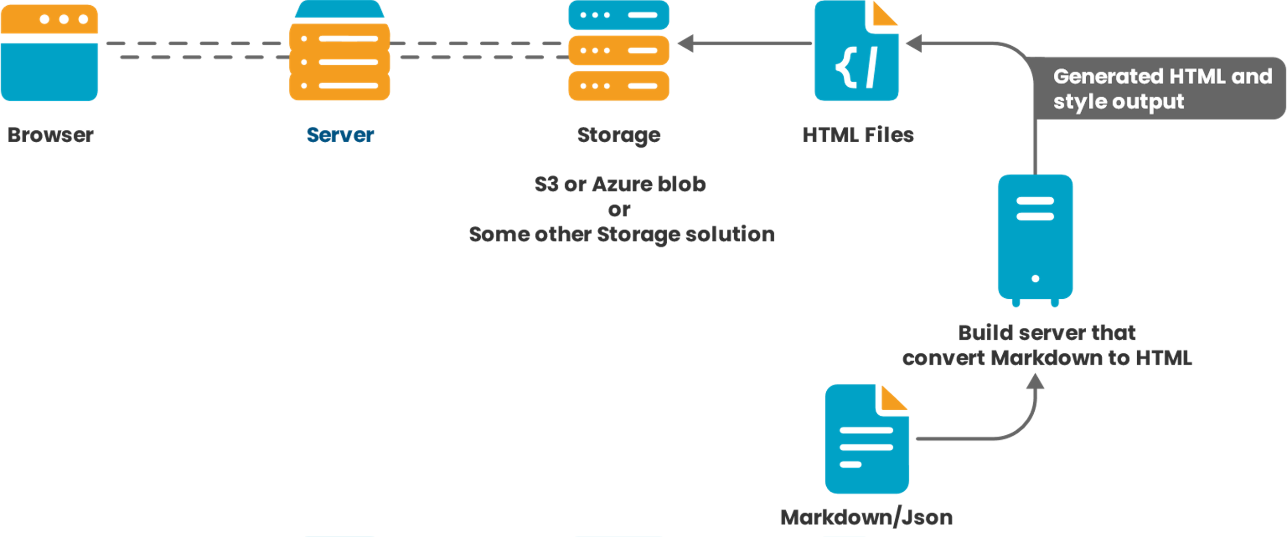
Static Website (Static Site Generators)
The Modern Web Development Landscape: Rendering paradigms

Slide 7
MPAs – Multi-Page Applications

Slide 8
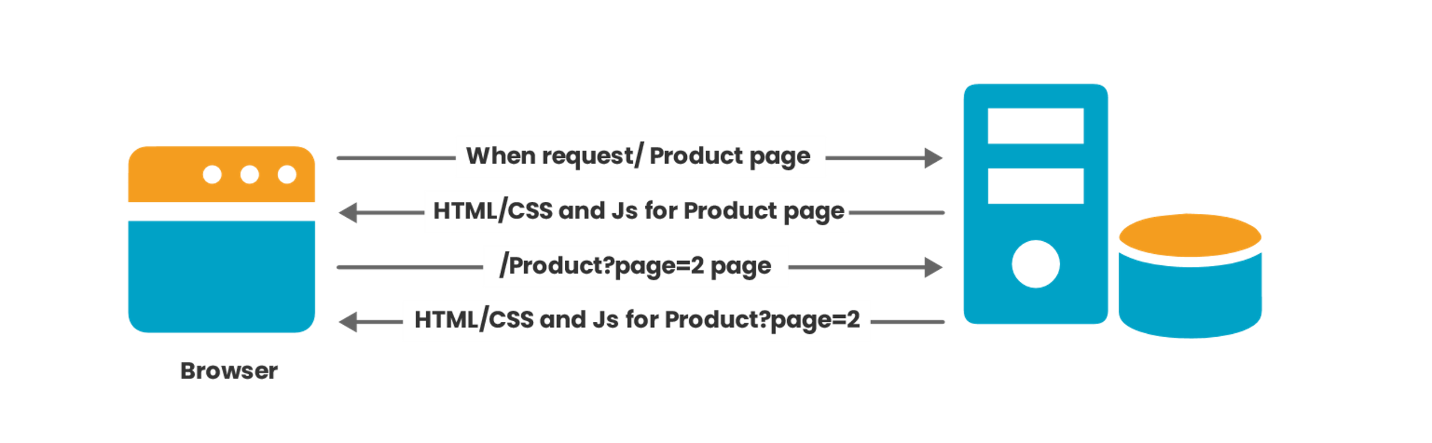
MPAs
The Modern Web Development Landscape: Rendering paradigms

Slide 9




What web frameworks available for building MPAs?
MPAs
The Modern Web Development Landscape: Rendering paradigms

Slide 10
MPAs
E Commerce
What are the use cases for MPAs
News Site
CRM/ ERP and other solution.
The Modern Web Development Landscape: Rendering paradigms

Slide 11
SPAs – Single Page Applications

Slide 12
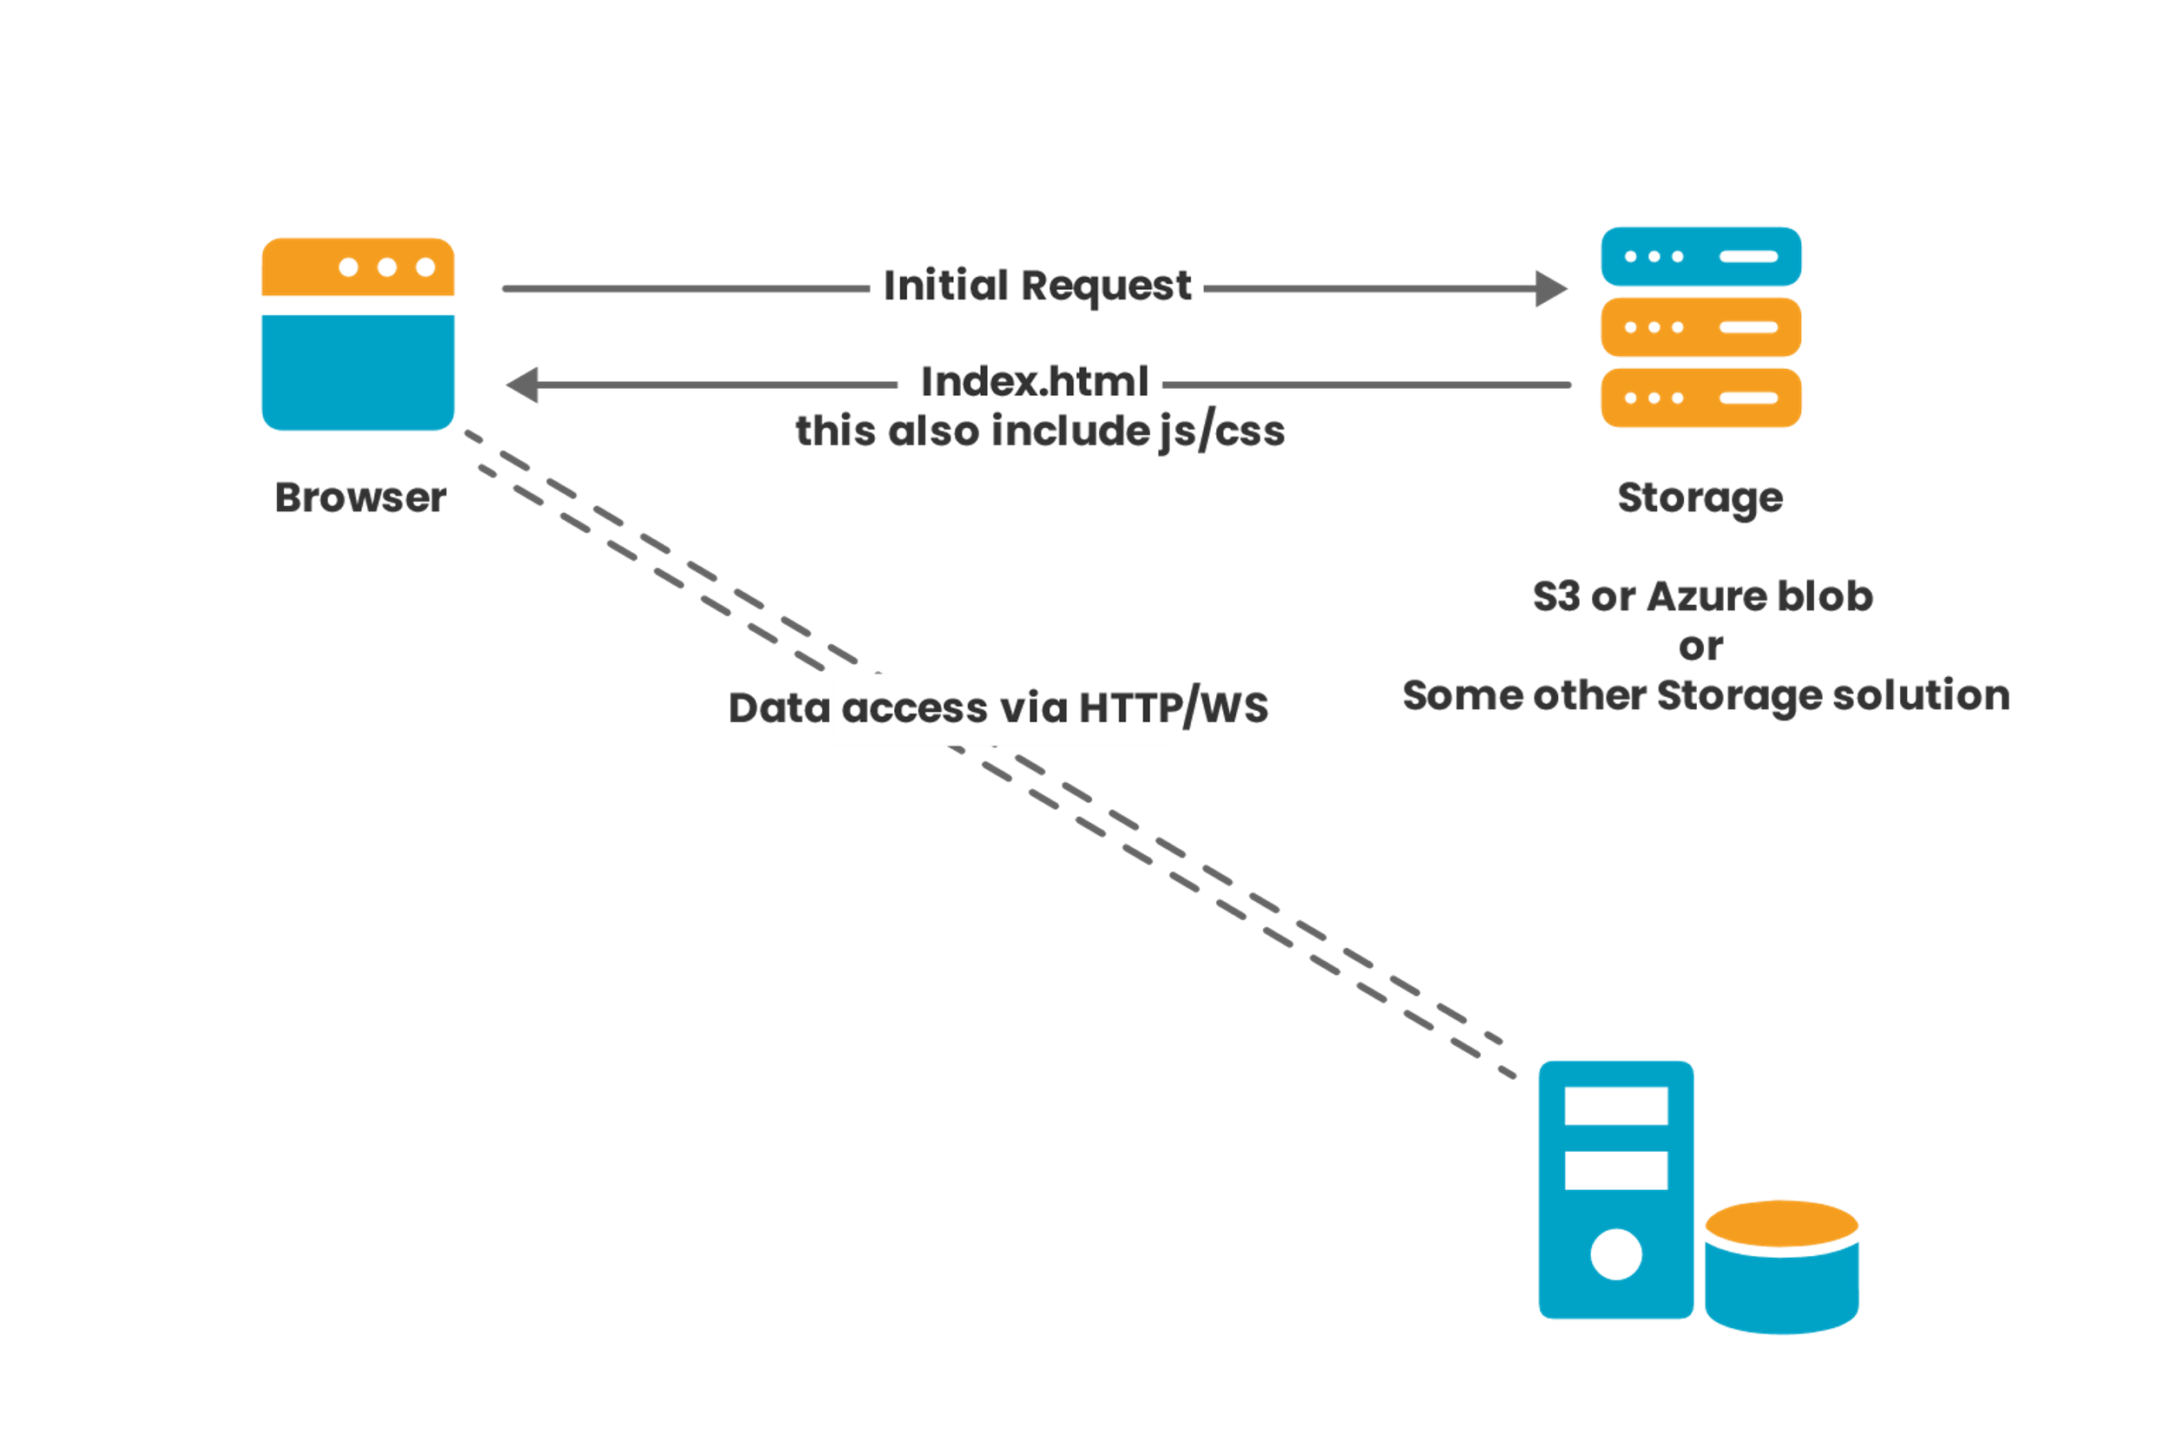
SPAs
The Modern Web Development Landscape: Rendering paradigms

Slide 13








What web frameworks available for building SPAs?
SPAs
The Modern Web Development Landscape: Rendering paradigms

Slide 14
Hybrid Rendering

Slide 15
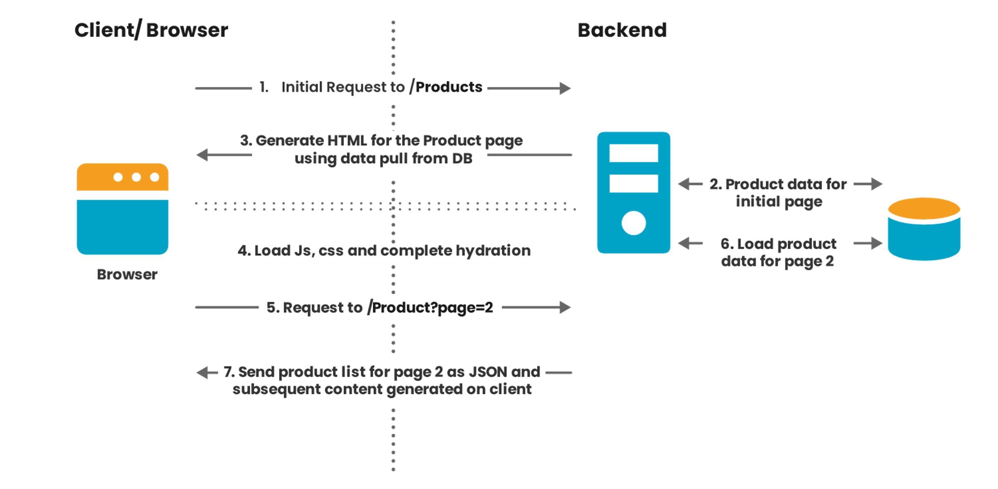
Hybrid Rendering (SSR with Hydration)
The Modern Web Development Landscape: Rendering paradigms

Slide 16





What tools and framework available for building Hybrid Rendering?
Hybrid Rendering (SSR with Hydration)
The Modern Web Development Landscape: Rendering paradigms

Slide 17
Web Development Approaches: Beyond the Norm

Slide 18
Web Assembly
The WASM Advantage
Running Complex Applications
How WASM Works
The Modern Web Development Landscape: Rendering paradigms

Slide 19
Summary....
Pattern | SEO | Client Heavy | Smooth UI/UX | Sever heavy | Dynamic content
Static Site | Yes | No | Yes | No | No
MPAs | Yes | No | No | Yes | Yes
SPAs | No/Minimal | Yes | Yes | No | Yes
Hybrid Rendering | Yes | Yes/can be reduced | Yes | Yes | Yes
Web assembly | No | Yes | Yes | Yes/depend | No
The Modern Web Development Landscape: Rendering paradigms

Slide 20

Thank you
For more information or application security support please contact Allion Technologies.
Email: info@alliontechnologies.com
Website: www.alliontechnologies.com

